Slide 1



Today:
Lluc Bono Rosselló
phD student @ULB
Large Language Models in the Real World

Slide 2
Introduction:
LLMs for me
Lluc Bono Rosselló
phD student @ULB

Slide 3

What are LLMs for you?
Experience: how do you use them?
Vision: How do you see them in your work environment in the next years?

Slide 4
OUTLINE
9-12H: LLMs Theory
What are LLMs?
How LLMs work: Embeddings and Transformers.
Multi-modal LLMs an possible use case.
Limitations of LLMs
How to extend LLMs? GPTs, Copilot and others.
Retrieval-Augmented Generation (RAG): a first use case
13-16H Use cases:
Retrieval-Augmented Generation (RAG): a second use case
Activity: Design your own RAG use cases

Slide 5

How LLMs work?
Large Language Models (LLMs) learn the statistical properties of language by predicting the next word in a sequence based on the context of preceding words.

Slide 6
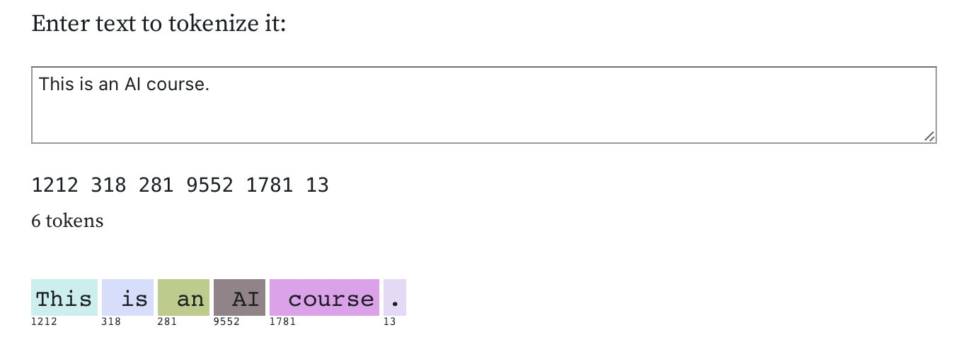
Tokens
Tokens are atomic units of text, which can be words, sub-words, or characters, separated by whitespace or punctuation, used as the basic building blocks for natural language processing tasks.

Slide 7
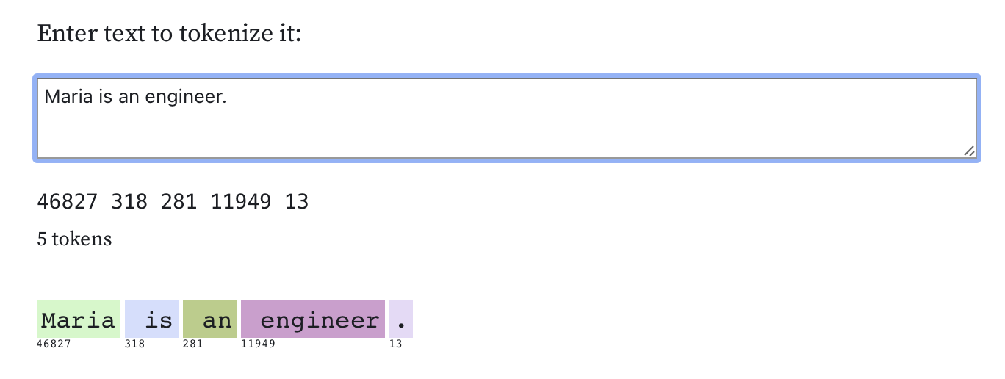
Tokens
Source: https://observablehq.com/@simonw/gpt-tokenizer

Slide 8
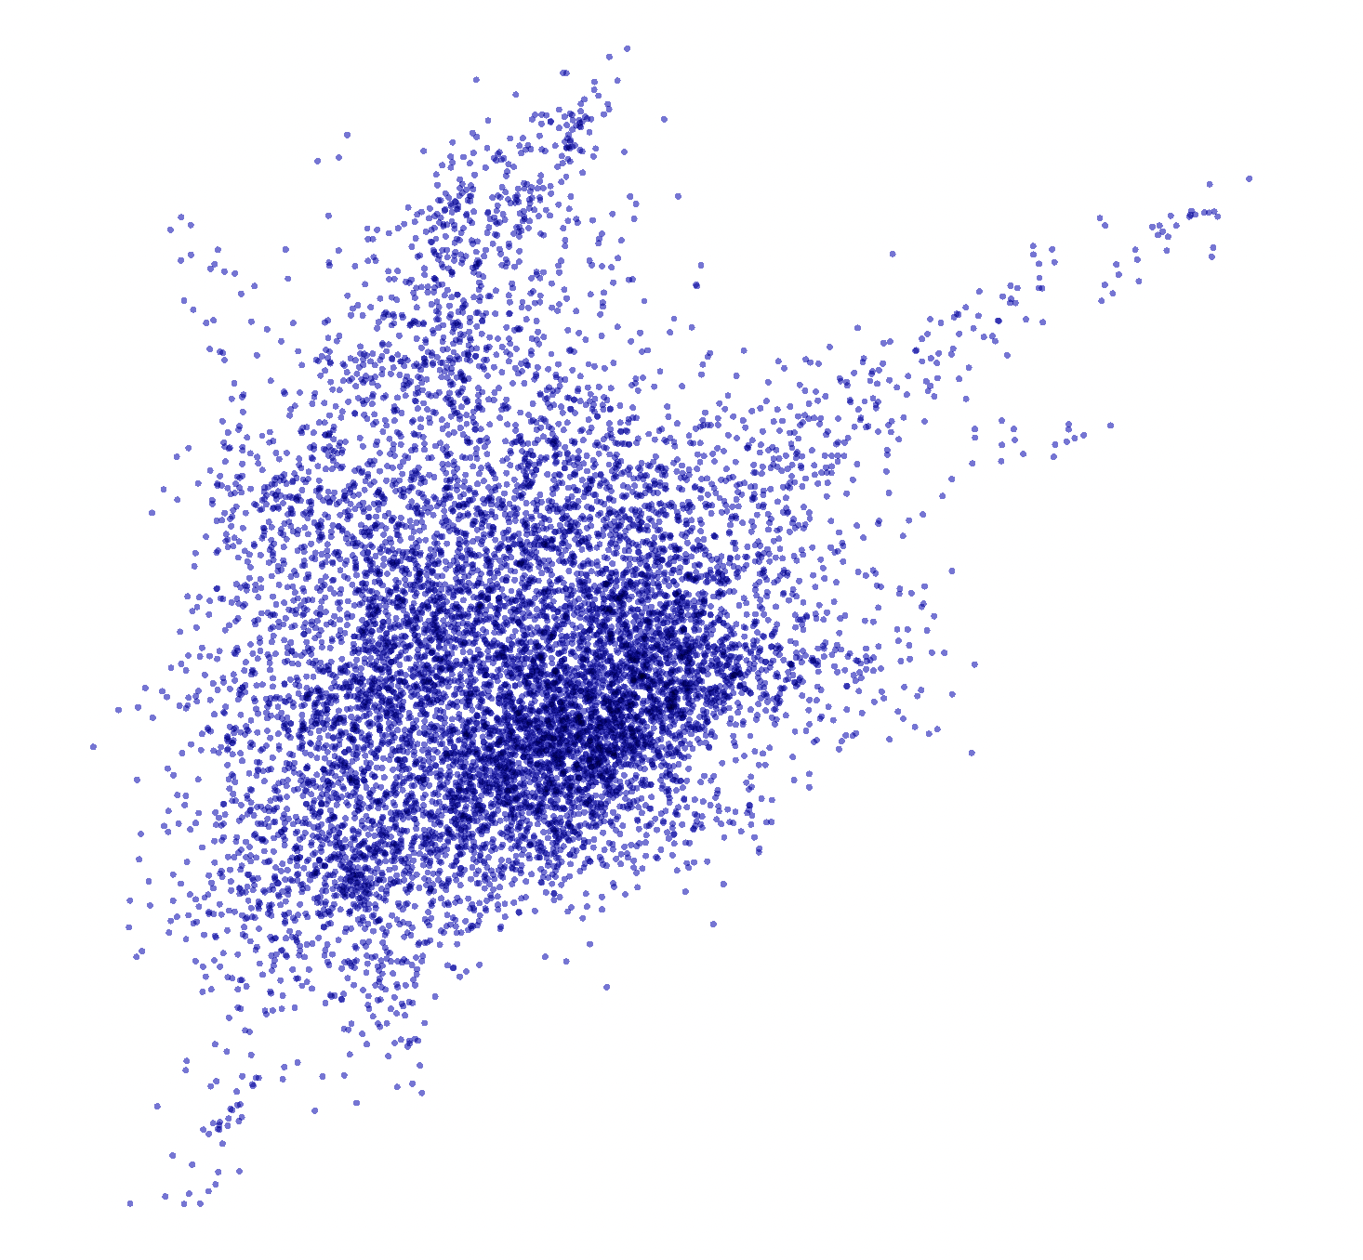


Embeddings
Text embeddings are dense vector representations of textual data that capture semantic information about words, phrases, or documents in a continuous vector space.
MODEL
https://projector.tensorflow.org

Slide 9
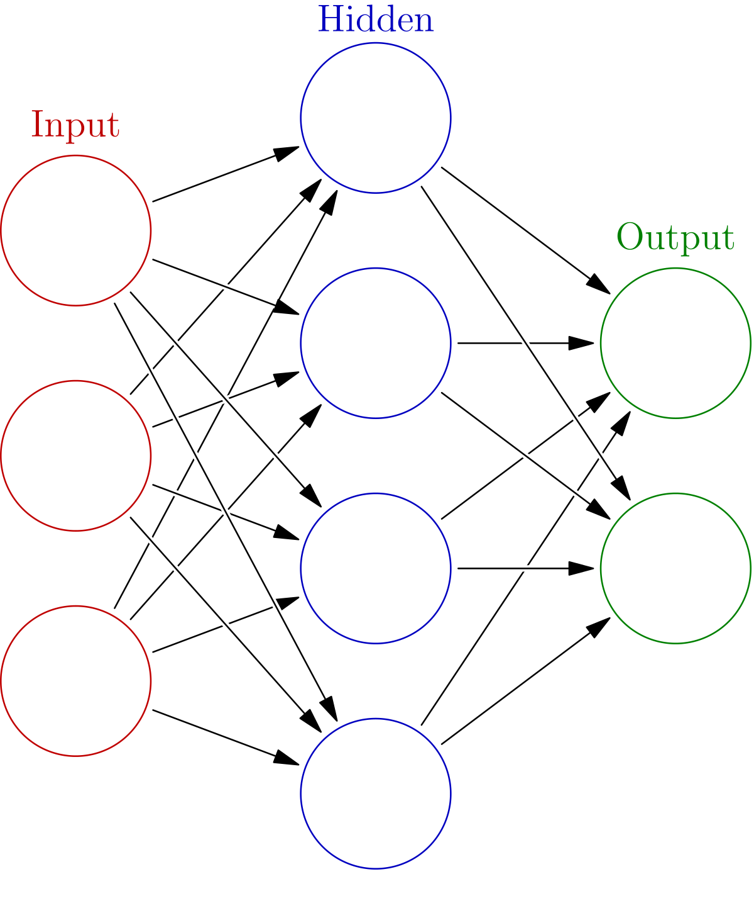
Neural Networks
TEXT
TEXT

Slide 10
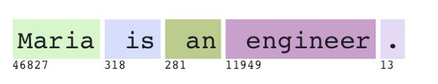
Neural Networks

Slide 11
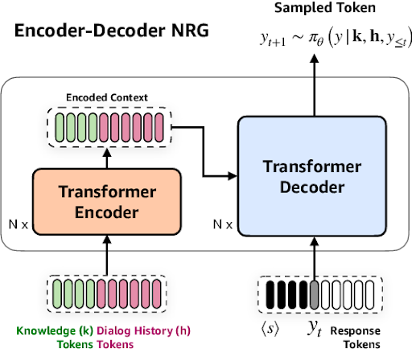
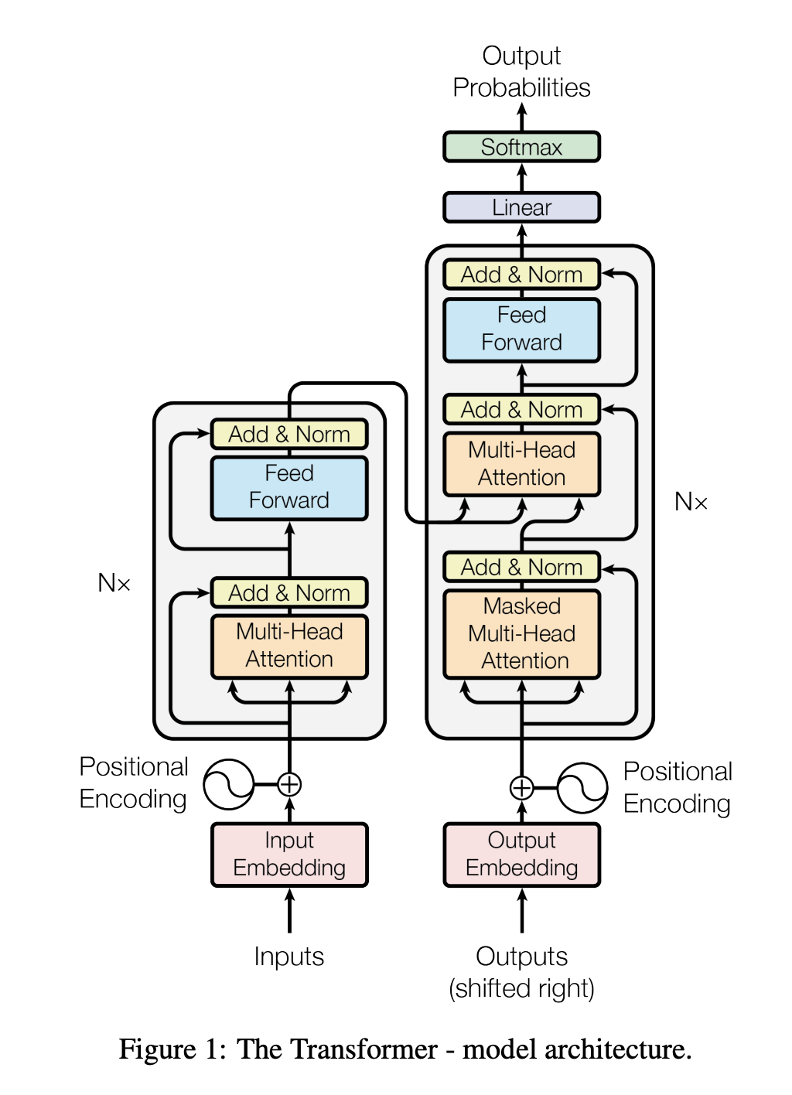
Transformers

Slide 12
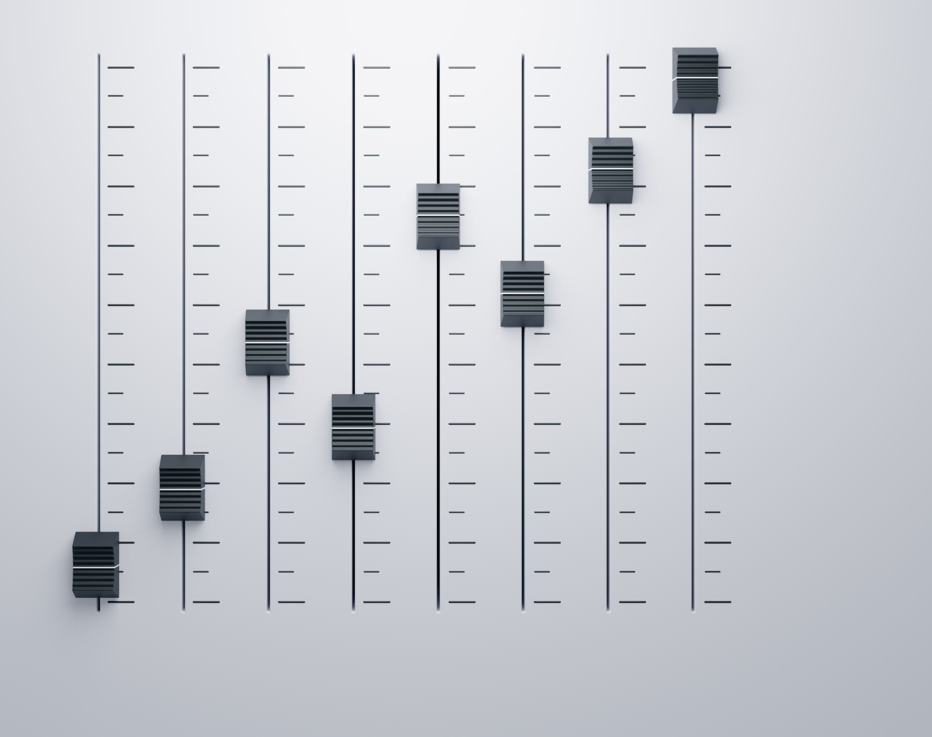
Multi-modal LLMs
Multi-modal Language Models (LLMs) extend traditional language models by incorporating additional modalities such as images and music as input or output, enabling comprehensive understanding and generation of content across various mediums.

Slide 13

Example of Multimodal use -case
FARI Animal Welfare Project

Slide 14
How can AI help controlling the ads online?
Ads are uploaded everyday.
Ads might stay online for a short period of time.
Validations using multiple data sources need to be done.
Conflicts can’t be identified in individual basis.

Slide 15
TECHNOLOGY:
Webscrapping
Natural Language Processing
Image Recognition
Data Analysis

Slide 16
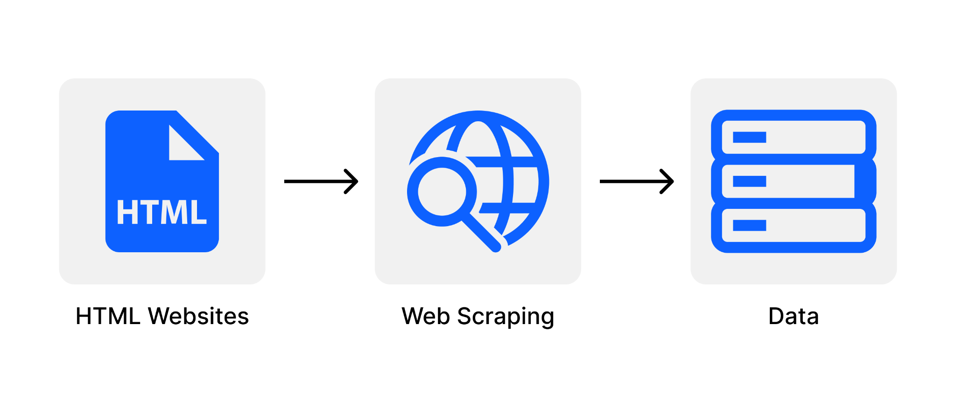
1. WEBSCRAPPING
‘is the process of extracting and collecting data from websites using automated software’

Slide 17




1. WEBSCRAPPING
‘is the process of extracting and collecting data from websites using automated software’

Slide 18
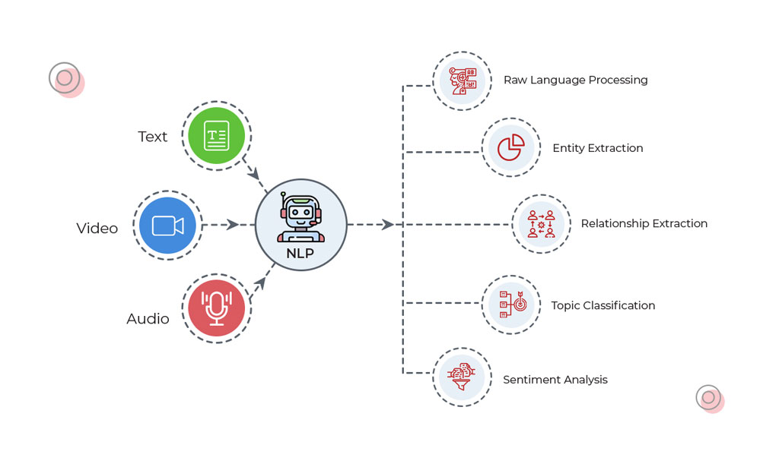
2. NLP Techniques: extracting the information.
‘are advanced computational methods used to understand, interpret, and generate human language’

Slide 19
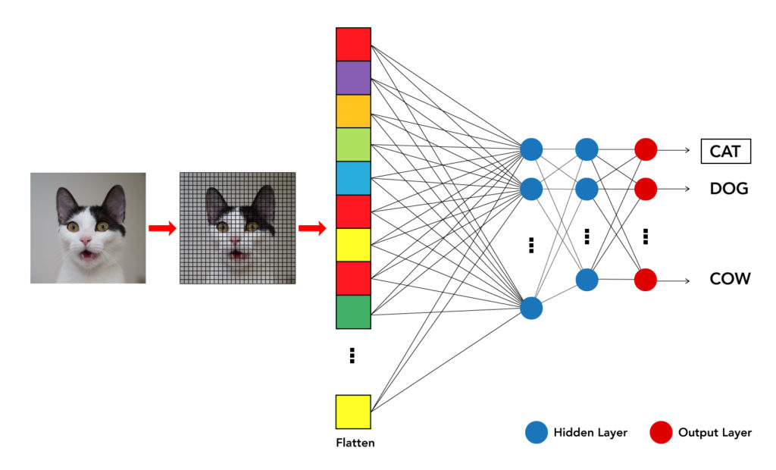
3. Image Recognition
‘involves using algorithms and machine learning models to analyse and identify specific features in images, such as distinguishing the presence of animals in a picture.’

Slide 20
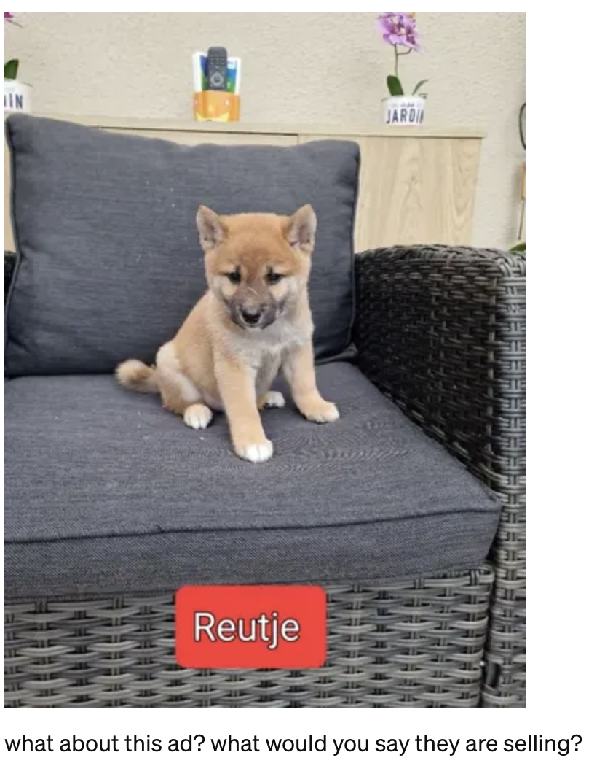
Example:
Why is this relevant or even needed?
Because we detected how some sellers used other product categories to post their ads, avoiding website’s control (for example)

Slide 21
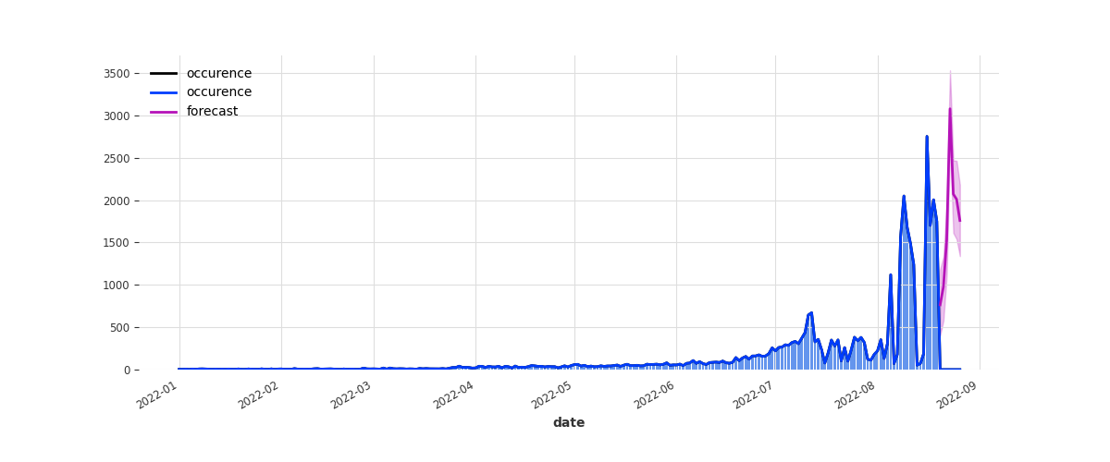
4. DATA ANALYSIS
‘encompass a range of statistical and computational methods used to examine, model, and forecast trends in time series data, including the detection of anomalies or unusual patterns.’

Slide 22
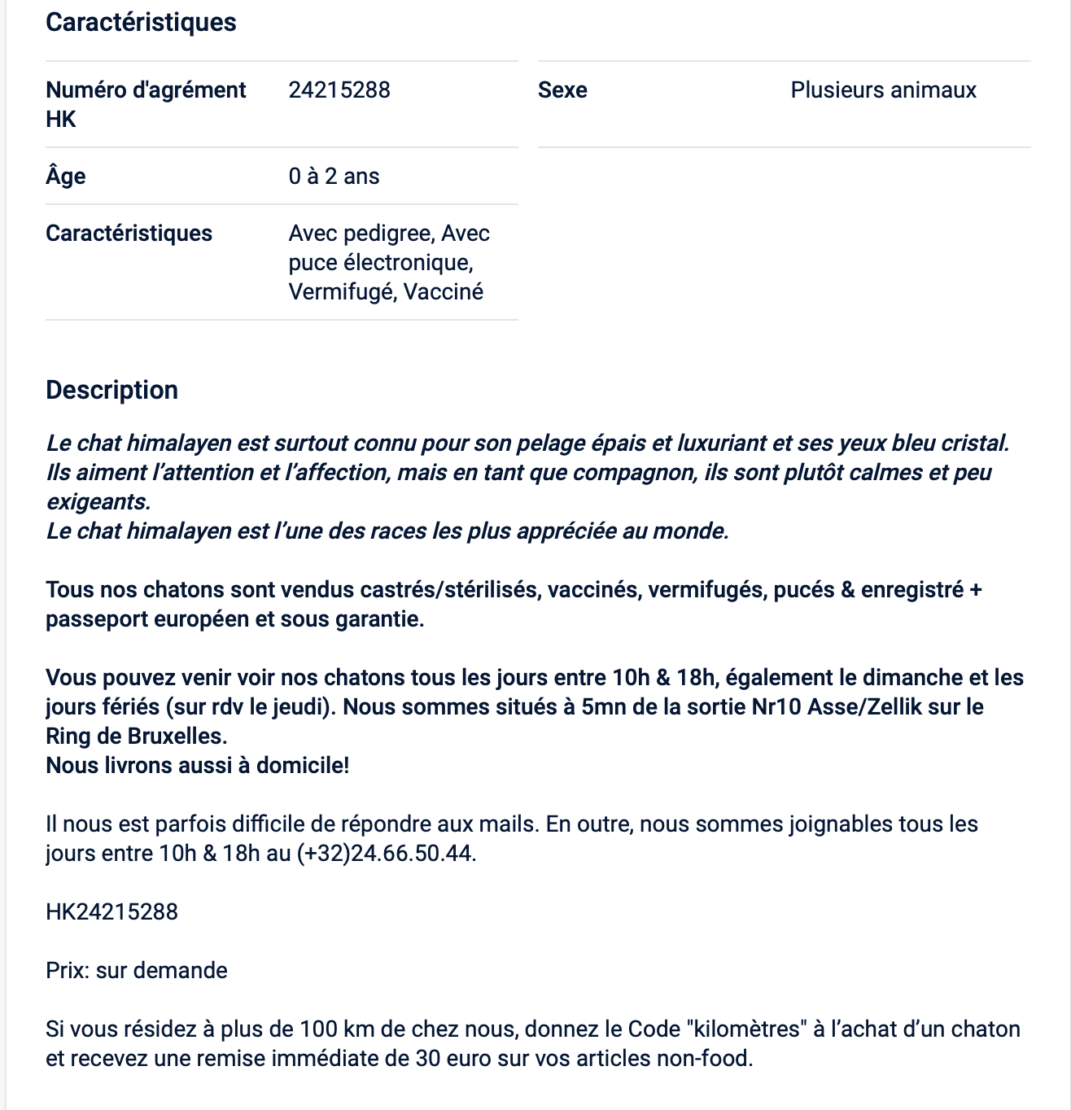
Example:
License: HK24215288
Animal: Cat
Phone Number: 3224665044
Mail: -
Place: Brussels
Price: none
Legal Mention: False.
…

Slide 23
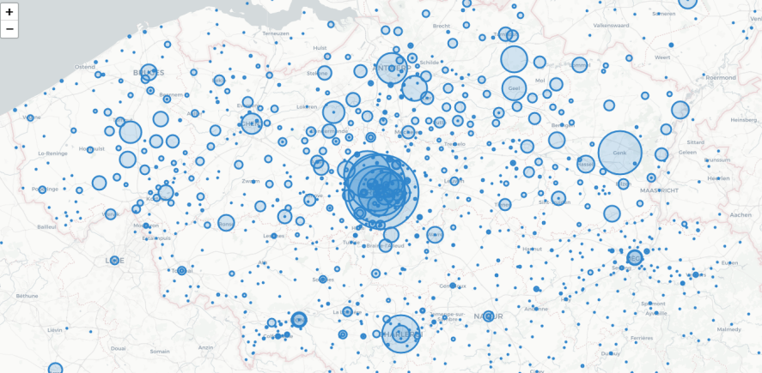
Example:

Slide 24
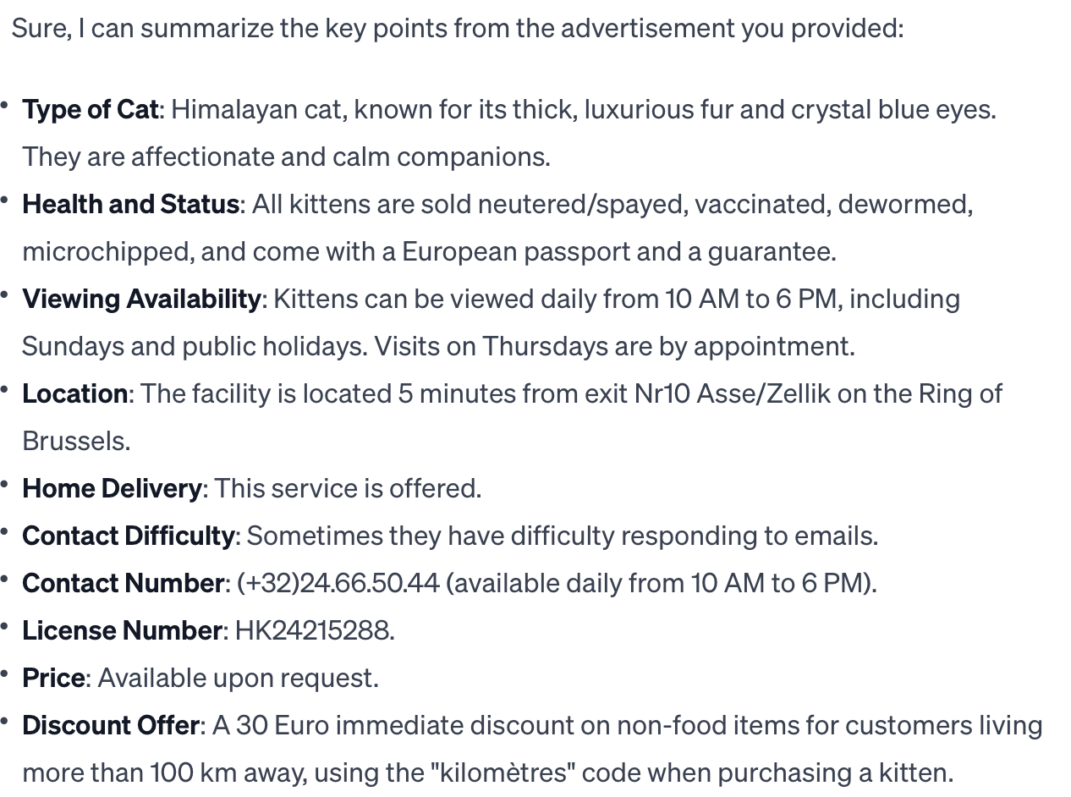
Using Large Language Models…

Slide 25
An multi-modal models…
The image shows a young puppy sitting on a cushioned chair, with the Dutch word "Reutje" indicating that the puppy is male. The puppy appears to be a Shiba Inu, which is a Japanese breed known for its fox-like features, including a dense coat, a confident expression, and a curled tail. The ad is likely for the sale of a Shiba Inu puppy. This breed is popular for its compact size, spirited personality, and relatively clean habits. The setting looks like a home environment, which suggests that the seller might be a private breeder or individual.

Slide 26
Questions?

Slide 27

PAUSE – coffee break

Slide 28

Limitations of LLMs?

Slide 29

Limitations of LLMs
Hallucination: generate plausible but entirely fabricated information or details, which can be misleading. This is particularly problematic when accuracy and truthfulness are critical.
Lack of Cited Sources: LLMs generate responses based on learned patterns from their training data without the ability to reference or cite specific sources for the information they provide.
Black-Box Nature: This opacity complicates efforts to debug or improve models, as well as to establish trust with users.
Biases in Training Data: LLMs can inherit and perpetuate biases present in their training data. These biases can manifest in outputs that reinforce stereotypes or discriminate against certain groups, raising ethical and fairness concerns.
Limited Understanding of Context and Nuance: LLMs may struggle with understanding context, nuance, or the subtleties of human language and culture. This can lead to responses that are inappropriate or miss the mark in understanding the user's intent.
Inconsistency :
LLMs can sometimes provide inconsistent or unpredictable responses to similar prompts.

Slide 30
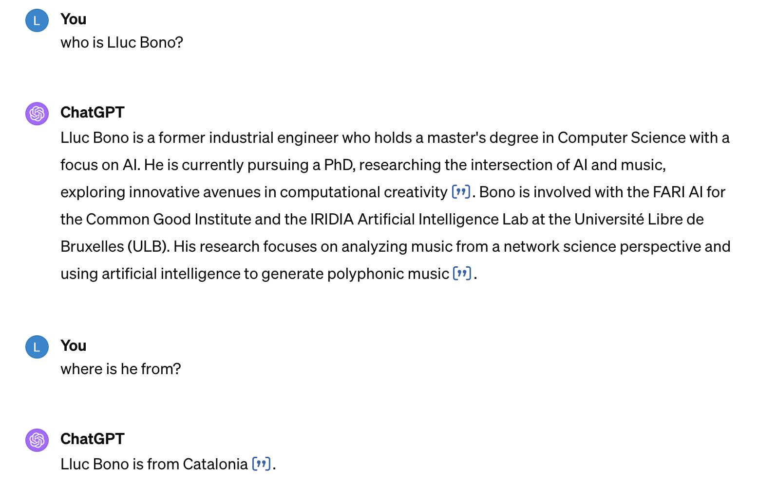
Hallucination Example

Slide 31

How are companies approaching these limitations?

Slide 32
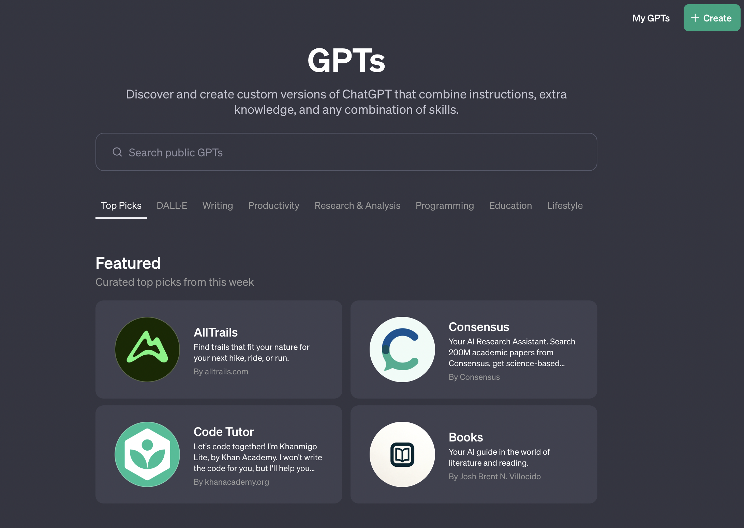

Slide 33

Same example with sources…

Slide 34

DEMO

Slide 35

Microsoft Copilot: Integrating LLMs in all applications…

Slide 36
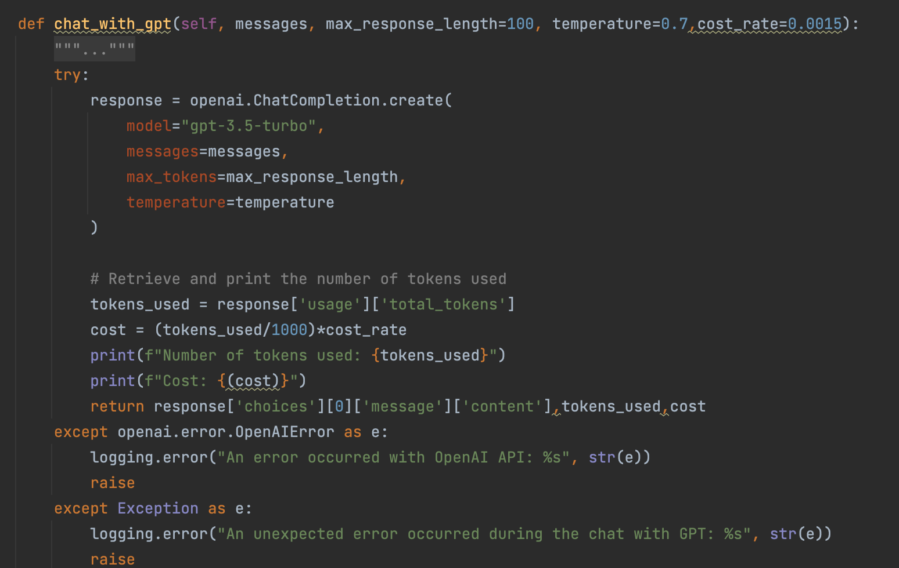
Or handmade…

Slide 37

So how does this work?

Slide 38

Introducing RAG schemes
What is RAG?
What Limitations can we overcome with this?
What is the difference between RAG and Fine-tuning?

Slide 39
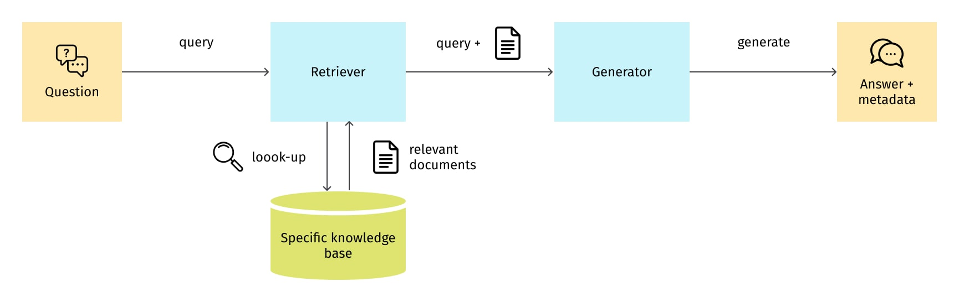
Retrieval Augmented Generation

Slide 40

And what about fine-tuning?

Slide 41
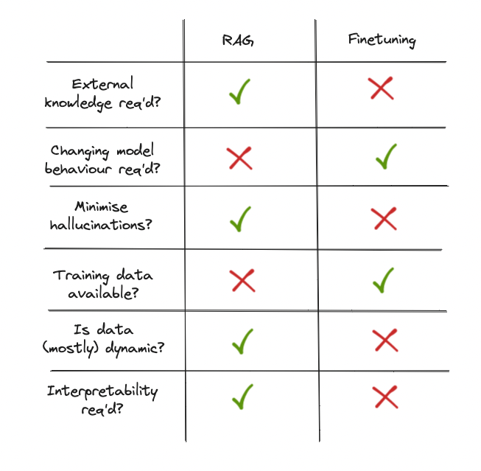
RAG vs Fine-Tuning
Fine-Tuning: The process of taking a pre-trained Large Language Model (LLM) and further training it on a smaller, specific dataset to adjust its parameters, so it becomes better at performing a particular task or understanding a specific domain, thereby customizing the model's responses and capabilities to meet unique requirements.
Source: https://www.linkedin.com/pulse/rag-vs-finetuning-which-best-your-llm-applications-sarfraz-nawaz/

Slide 42
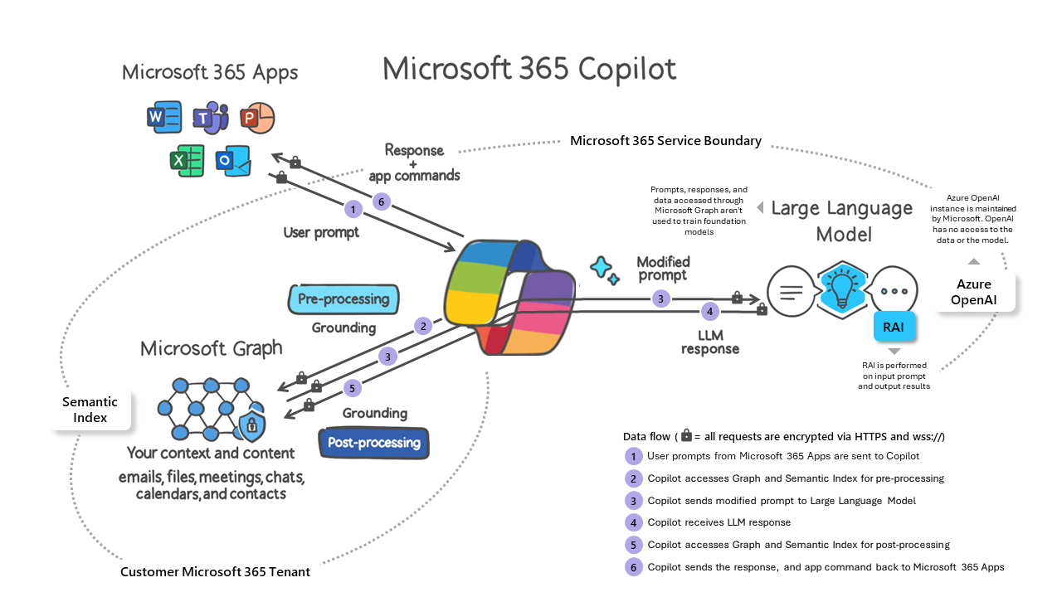
Source: Microsoft

Slide 43
Limitations of LLMs
Hallucination: generate plausible but entirely fabricated information or details, which can be misleading. This is particularly problematic when accuracy and truthfulness are critical.
Lack of Cited Sources: LLMs generate responses based on learned patterns from their training data without the ability to reference or cite specific sources for the information they provide.
Black-Box Nature: This opacity complicates efforts to debug or improve models, as well as to establish trust with users.
Biases in Training Data: LLMs can inherit and perpetuate biases present in their training data. These biases can manifest in outputs that reinforce stereotypes or discriminate against certain groups, raising ethical and fairness concerns.
Limited Understanding of Context and Nuance: LLMs may struggle with understanding context, nuance, or the subtleties of human language and culture. This can lead to responses that are inappropriate or miss the mark in understanding the user's intent.
Inconsistency :
LLMs can sometimes provide inconsistent or unpredictable responses to similar prompts.

Slide 44

USE CASE:
UNIVERSITY SUPPORT
Description of use case: Chatbot to provide support related to university.
Why?
  Data is there but students can’t find it.
  Data is updated constantly.
  Support team getting tickets for information that is there.

Slide 45

Current State
How do you think a Chatbot used to work?

Slide 46
University Support
Description of use case:
Chatbot to provide support related to university.
Target users:
Students,
professors,
admin
Data:
Articles and Internal Information
Challenges:
Multilingual, Hallucination,
Sources,
Deployment,
different authentication,

Slide 47
Retrieval Augmented Generation

Slide 48
Retrieval Augmented Generation
DATA: Articles

Slide 49

The retriever

Slide 50
How?
Key-word search/ Edit-search
Use of embeddings

Slide 51
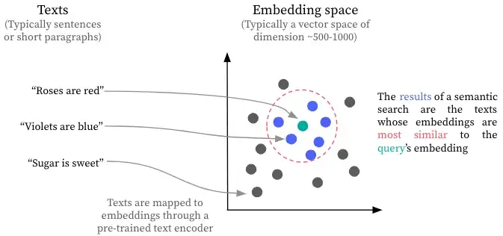
Vector Search

Slide 52

Which Embedding Model to use?
If the data is not well represented, the matching of our query won’t be relevant.
Two words can be very similar in one context, yet very different if we are in a more specialised context.

Slide 53
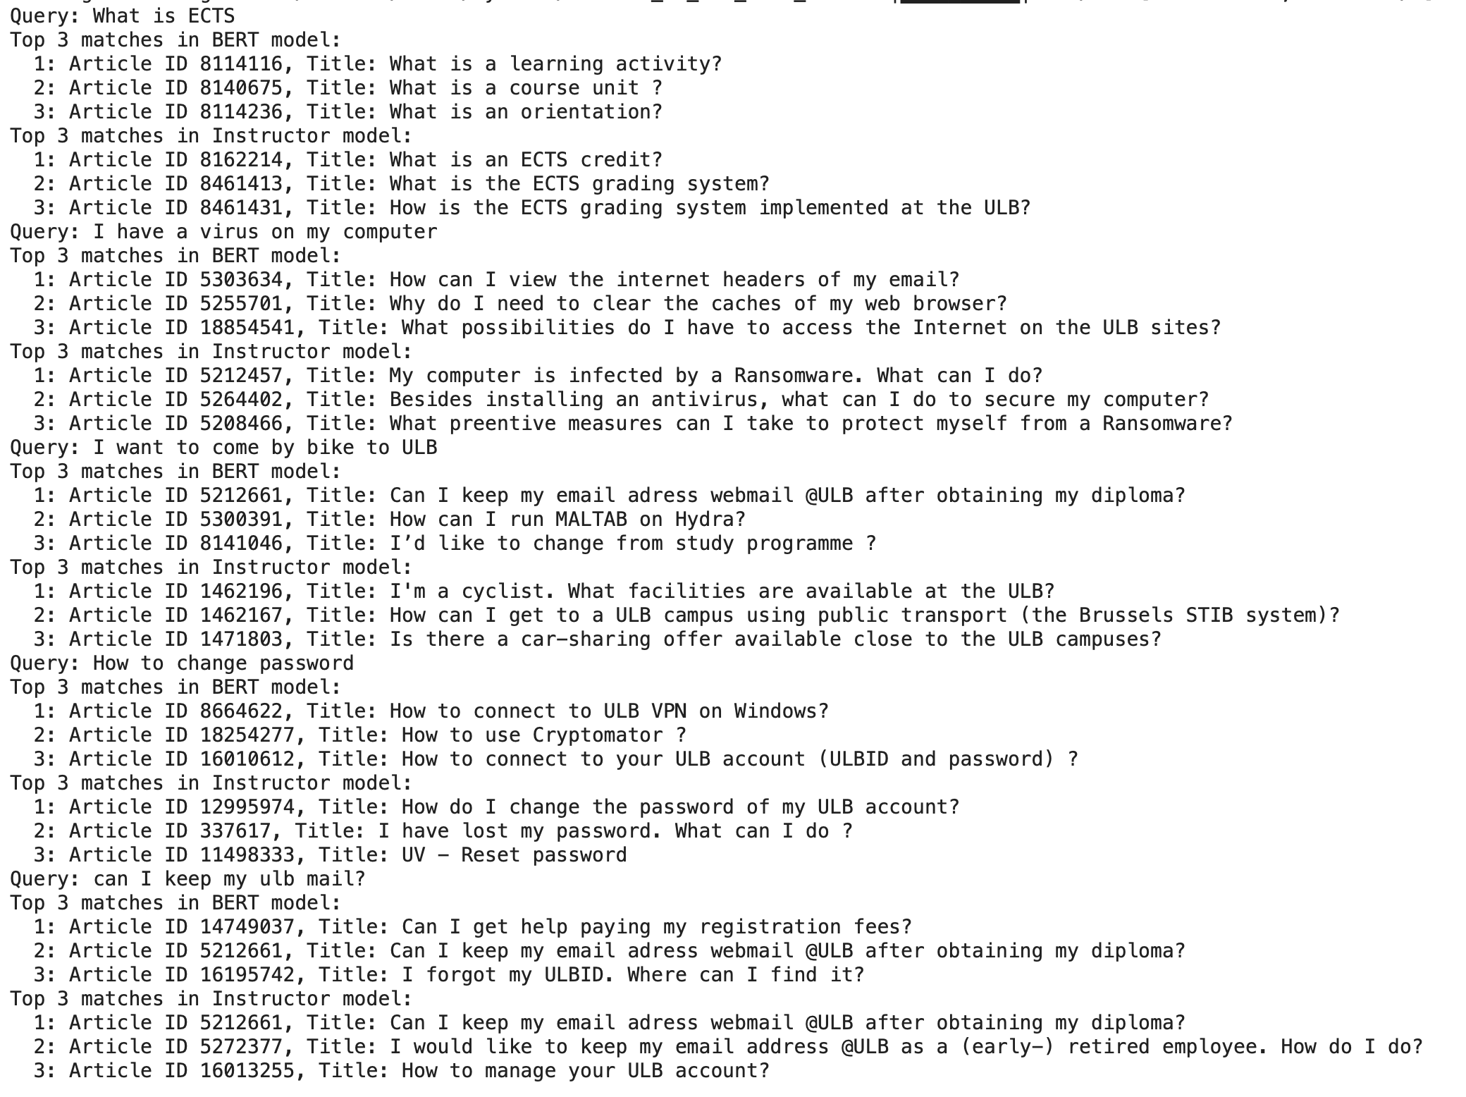


BERT VS INSTRUCTOR

Slide 54


SCHEME RAG LLM
ANSWER
QUESTION
QUESTION EMBEDDING
MATCH EMBEDDINGS
LLM PROMPT
SELECTED PAGES
PAGES EMBEDDINGS
LIFERAY PAGES

Slide 55

Challenge:
What if the query is in French?

Slide 56
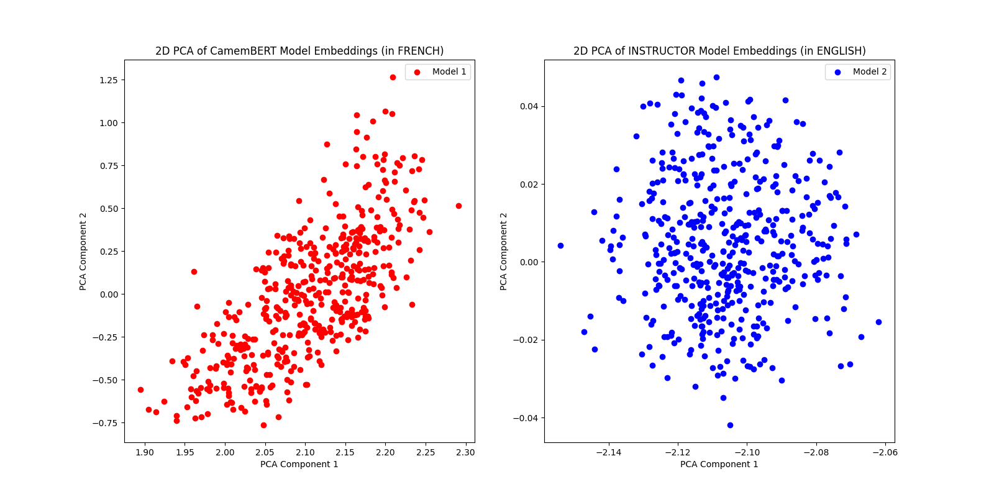
CamemBERT vs Instructor
(1) What is the embedding model that better represents our data?

Slide 57

Let’s see…

Slide 58
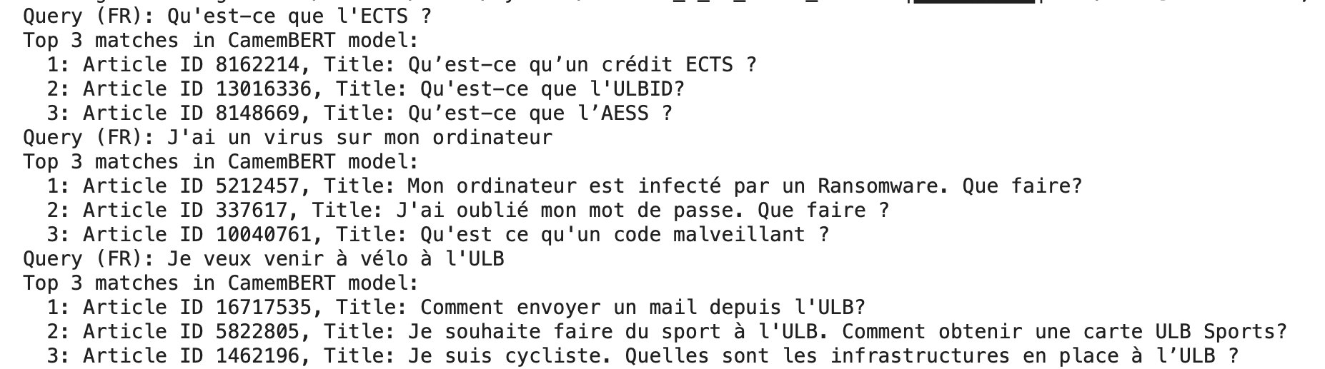
CamemBERT (the French Model)

Slide 59

Other ideas?

Slide 60
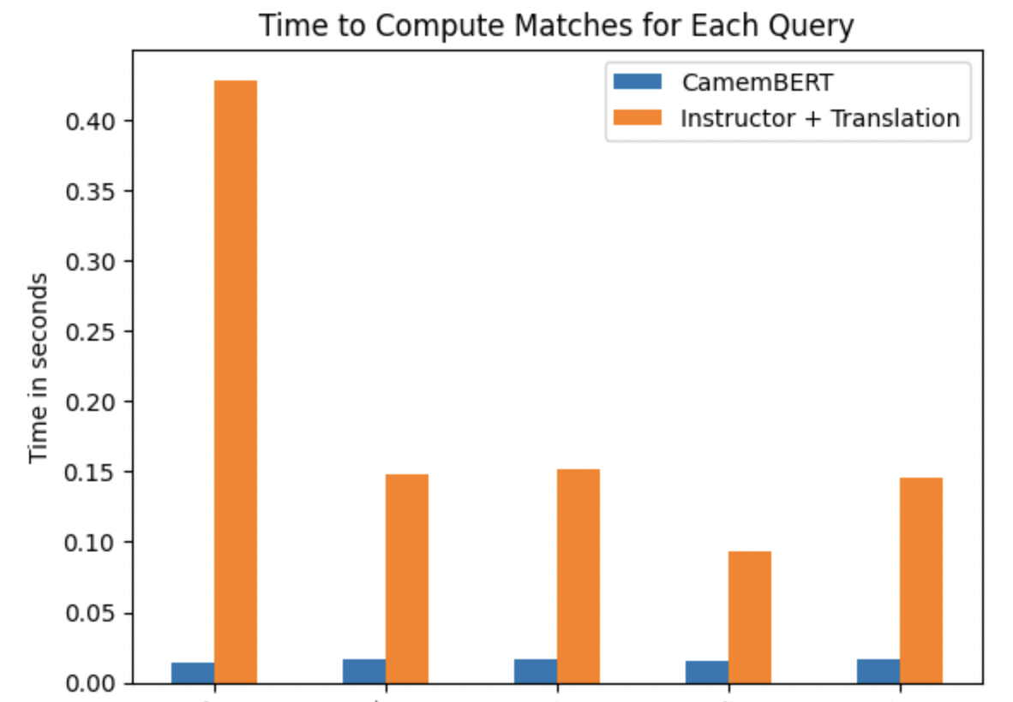
Automated Translation
Use a translation model to translate the query, produce the matching in english and then select the content in french to create the answer.
Problem: Computation of the translation might not be accurate or time consuming. Lets see…

Slide 61
Summary: Current Scheme
ANSWER
QUESTION
QUESTION EMBEDDING
en
?
MATCH EMBEDDINGS
LLM PROMPT
translate
fr
SELECTED PAGES
PAGES EMBEDDINGS
translate
LIFERAY PAGES

Slide 62

What if the user just says: Hi?

Slide 63
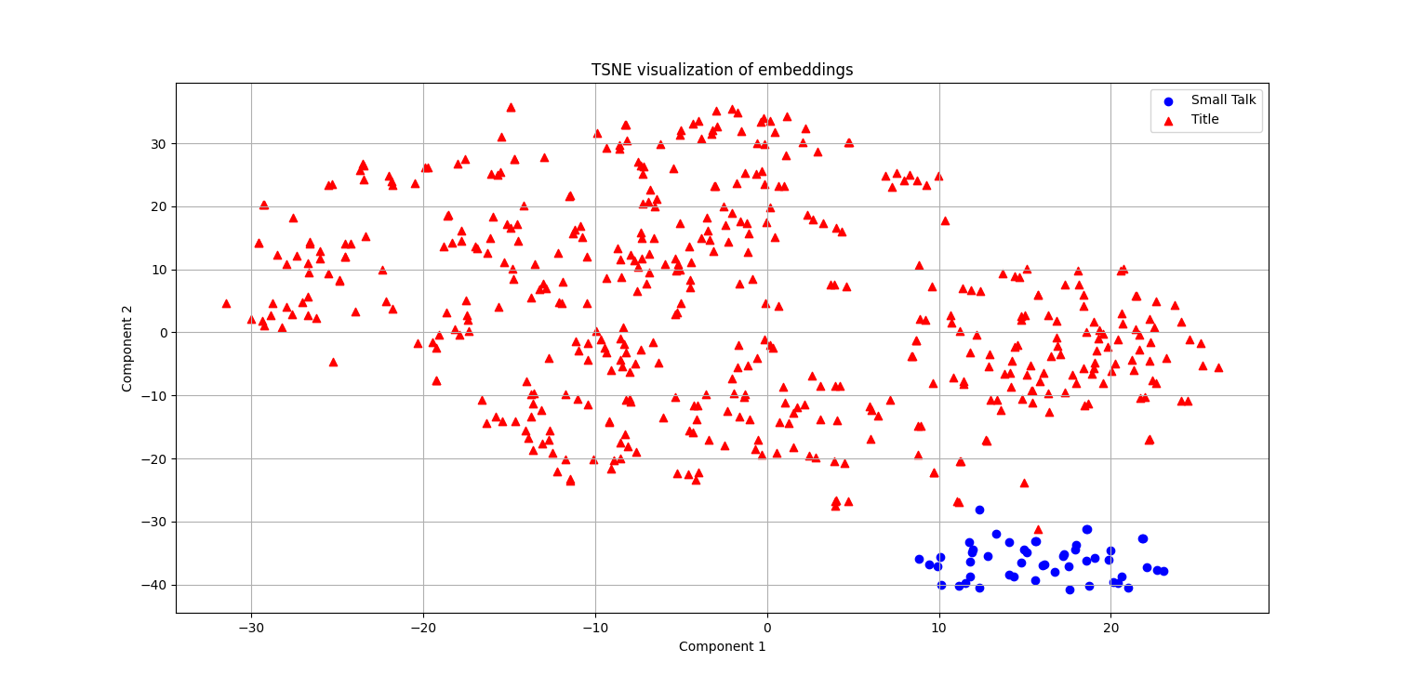
Capturing Small-Talk through Embeddings

Slide 64

Different users authentication
How do we make sure each user obtains answers from its level-authenticated data?

Slide 65

The prompt
Prompt
User Query
Relevant Documents

Slide 66
Demo

Slide 67

Moving into real-world…
The deployment

Slide 68
How did we face some of the challenges…
Multilingual:
2 tests, french model and translation.
Sources:
sending links bypassing the LLM
Different targets/authentication
with different knowledge bases
Deployment:
via integration into other software.

Slide 69

BREAK

Slide 70

R&D TEAM: CHEMISTRY/NUTRITION
Description of use case: Company deparment in charge of product development. Investigate literature on effects of certain vitamins.

Slide 71
R&D TEAM: CHEMISTRY/NUTRITION
Description of use case: Company deparment in charge of product development. Investigate literature on effects of certain vitamins.

Slide 72

R&D TEAM: CHEMISTRY/NUTRITION
Description of use case: Company deparment in charge of product development. Investigate literature on effects of certain vitamins.
Target Users?

Slide 73

R&D TEAM: CHEMISTRY/NUTRITION
Description of use case: Company deparment in charge of product development. Investigate literature on effects of certain vitamins.
Target Users: Scientific/Researchers

Slide 74

R&D TEAM: CHEMISTRY/NUTRITION
Description of use case: Company deparment in charge of product development. Investigate literature on effects of certain vitamins.
Target Users: Scientific/Researchers
Data?

Slide 75
R&D TEAM: CHEMISTRY/NUTRITION
Description of use case: Company deparment in charge of product development. Investigate literature on effects of certain vitamins.
Target Users: Scientific/Researchers
Data: Scientific Papers

Slide 76
R&D TEAM: CHEMISTRY/NUTRITION
Description of use case: Company deparment in charge of product development. Investigate literature on effects of certain vitamins.
Target Users: Scientific/Researchers
Data: Scientific Papers
Challenges?

Slide 77
R&D TEAM: CHEMISTRY/NUTRITION
Description of use case: Company deparment in charge of product development. Investigate literature on effects of certain vitamins.
Target Users: Scientific/Researchers
Data: Scientific Papers
Challenges: Lots of Data. Scalability. Hallucination. Sources. Technical Language. Evaluation. Data Access. Webscrapping. Updates of Data. Privacy/security. Article length. References.

Slide 78
Query: Relevant vitamins for diet?
Answers specific to scientific context (or local use-case context)
Source of the information is tracked (no hallucination)
Prompt
+
LLM
Relevant Context
Database

Slide 79
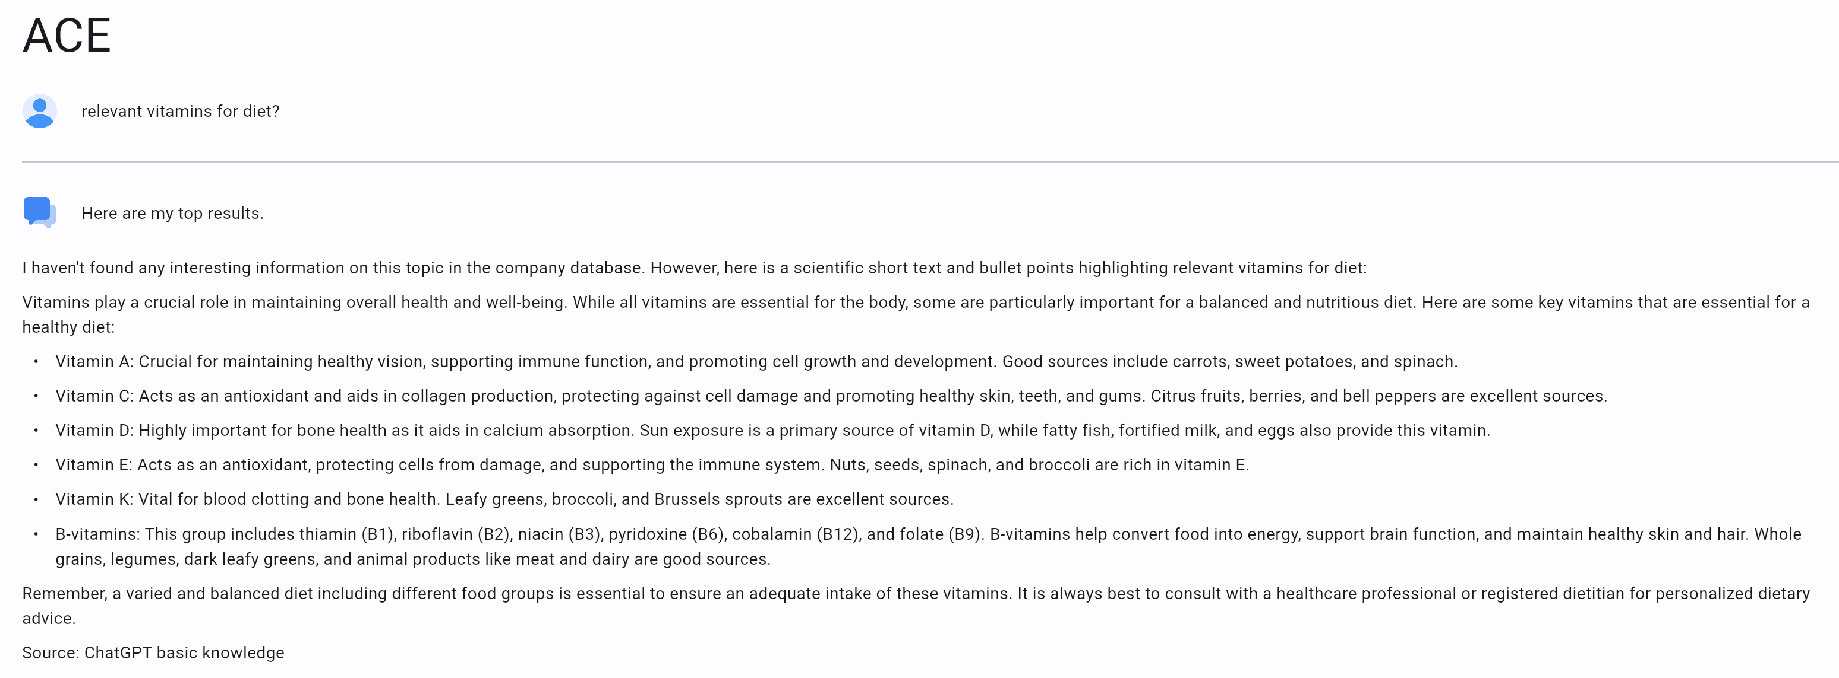
Our retriever was not finding the right content…

Slide 80

Search Mechanisms
Classic Edit-search
Use of Embeddings

Slide 81
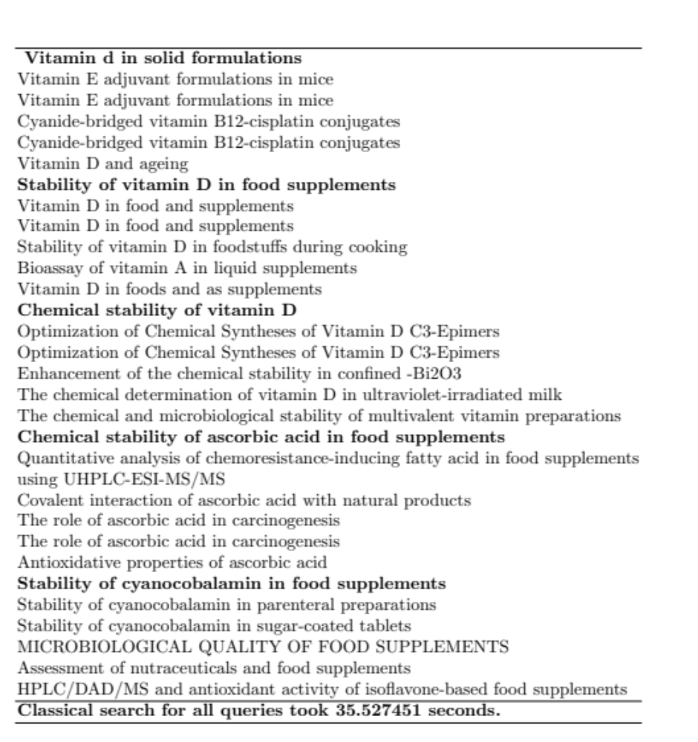
EDIT-DISTANCE SEARCH (CURRENT APPROACH)

Slide 82
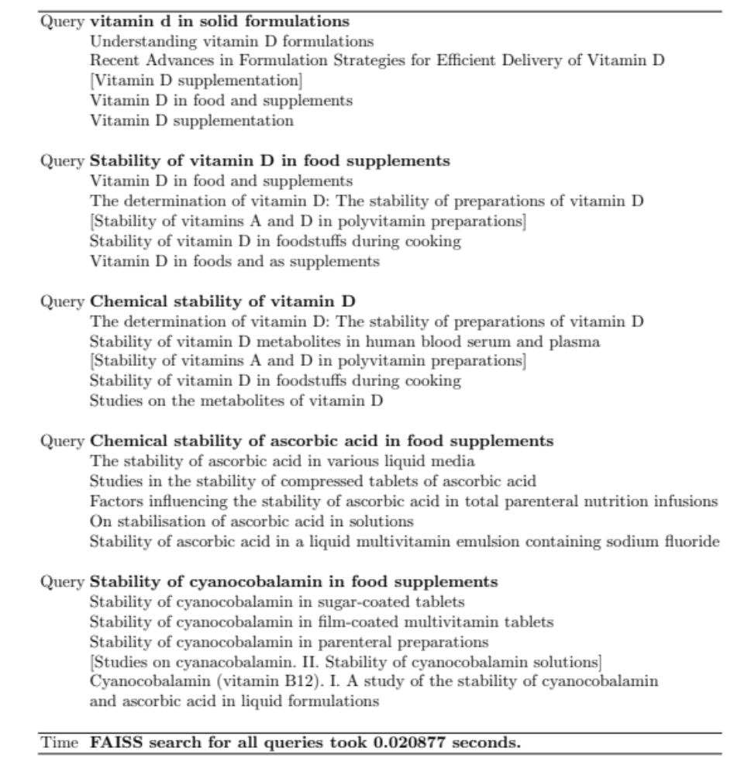
FAISS SEARCH EMBEDDING: INSTRUCTOR

Slide 83
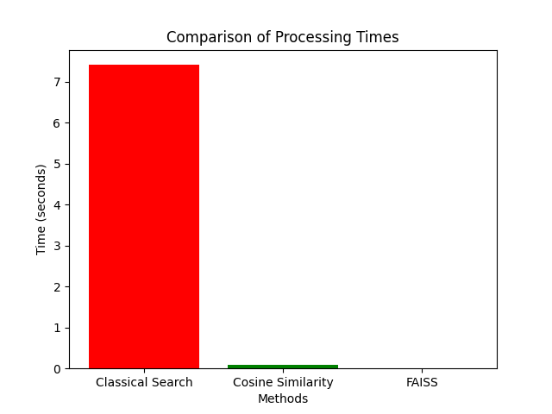
Comparison with previous search

Slide 84
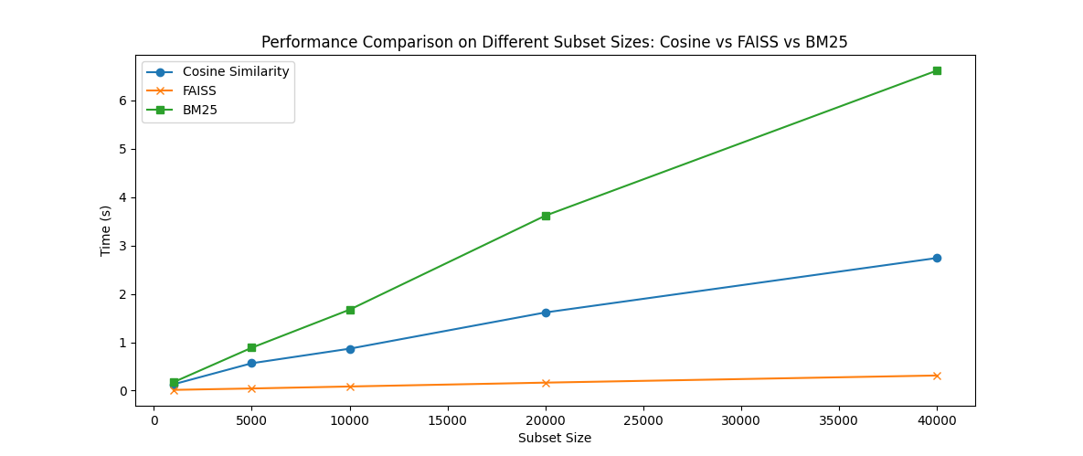
BM25 a –reasonable- alternative to Embeddings. (100 queries)

Slide 85
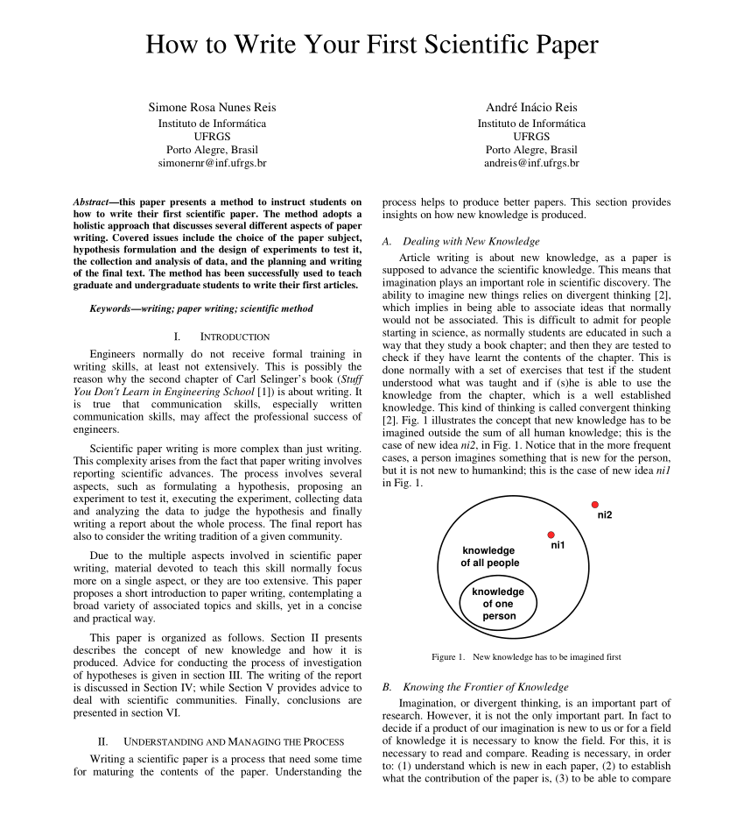
Still some decisions to make…
Where do we look for the content?

Slide 86
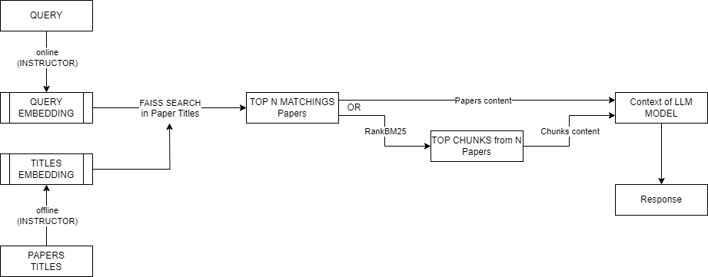
Current Status
Quality and Efficiency of the search with the same dataset has been drastically improved.
Multiple Sources are used to answer single query.
Solution has been easily integrated in previous application.

Slide 87

How did we face some of these challenges?
Hallucination: RAG
Data Access: APIs, internal library, security via Microsoft
Evaluation: User testing
Scalability and Technical Languages: Improve Search, use of Embeddings

Slide 88

Build your own use case

Slide 89
ACTIVITY: Define your use case
Use case identification and description:
  By teams/groups identify and define a use case
  Look for data overloads or needs for technical information
  Think of it as a very productive assistant

Slide 90
ACTIVITY: Define your use case
Use case identification and description.
Identify data and target users.
  Where is the data? Is it internal or external? Is it public?
  Do we need to pre-process it?
  Do we have multiple sources of data?
  Who is going to use the tool? Do we have different kind of users?
  Do different users expect different output? Do they have access to different data?

Slide 91
ACTIVITY: Define your use case
Use case identification and description.
Identify data and target users.
Implementation and Technical Challenges:
  Design a scheme.
  How do You need to adapt the technology to your use case?
  What are the main challenges? Adoption? Scalability? Maintenance? Evaluation?
  How feasible is this?

Slide 92
SCHEME
OTHER INPUT?
Prompt?
USERS?
MODEL?
DATA?

Slide 93
SCHEME
OTHER INPUT
PROMPT + QUERY+ DATA
USERS
PRE-PROCESSING
ANSWER
RETRIEVER
LLM
Metadata
DATA SOURCES

Slide 94

Final Discussion

Slide 95
Thanks
Contact: Lluc.Bono.Rossello@ulb.be
Lluc Bono Rosselló
phD student @ULB

